Slide 1
Using JX Connectors To Notify States and Counties of a Nuclear Emergency
Andy Kalchik

Slide 3
Overview
During an emergency, nuclear sites must (by regulation):
Classify – Within 15 minutes of emergency conditions, figure out how bad it is
Call-out – If the accident is bad enough, Operators activate our internal emergency response facilities. They call-out Duke Energy emergency responders.
Notify – Within 15 minutes of classifying, message the surrounding states and counties AND validate they received it
Using JX Connectors, WebEOC is helping us call-out our Duke Energy emergency responders and notify states and counties

Slide 4
Current way to Call-out
Operators find appropriate code in a procedure
Operators call Security and ask them to sound the code
Security logs into ERONS, our internal name for Everbridge, and calls responders
Call-out to staff internal emergency response facilities is required if the emergency is an Alert or higher

Slide 5
Current way to Notify
Fill out Emergency Notification Form in WebEOC
Transmit Form in WebEOC
Validate states and counties received the message using a custom IP phone system
Pick up phone and press a button to dial all surrounding states and counties at once
Wait for all states and counties to answer
Read a script based informing them of the Classification (i.e. how bad)
Ensure everyone received the message and answer any questions

Slide 6
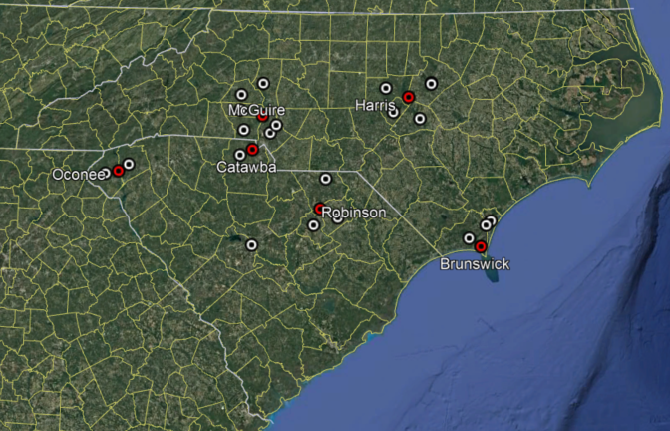
Problems
The custom phone system is expensive
Phones are installed at the Control Rooms for each nuclear site, every state and county Warning Point and EOC, our Emergency Operations Facility, and numerous test locations
Each phone has multiple redundant internet connections that must be maintained
The custom IP phone provider is also expensive
The current system diverts attention of a nuclear operator while managing an emergency
The current system diverts attention of 911 Operators who need to respond to medical, fire, police, and other emergencies
The classification and other info needs to be entered / used twice when notifying states/counties and calling emergency responders

Slide 7
Solution
Use WebEOC to get response, rather than the custom phone system
JX Connectors tie WebEOC to Everbridge
Everbridge serves as the “engine” to call states, counties, and emergency responders
WebEOC serves as a custom user interface, tailor made for nuclear emergency response

Slide 8
(1) New way

Slide 9
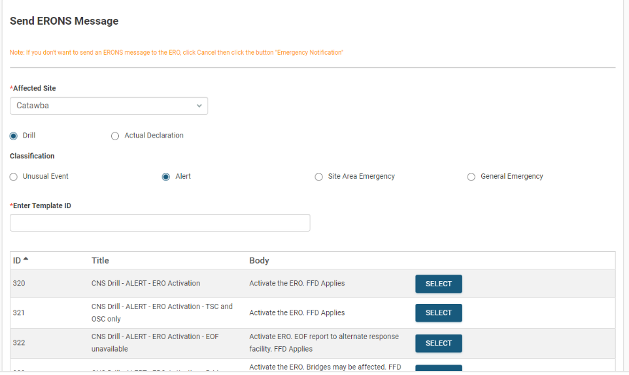
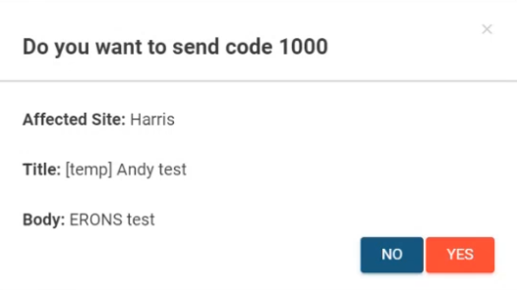
(2) New way to Call-out
320
Catawba
CNS Drill – ALERT – ERO Activation
320
Activate the ERO. FFD Applies.
Notes:
There is a simulator feature of the board which works the same as the real version, but doesn’t contact states / counties or emergency responders

Slide 10
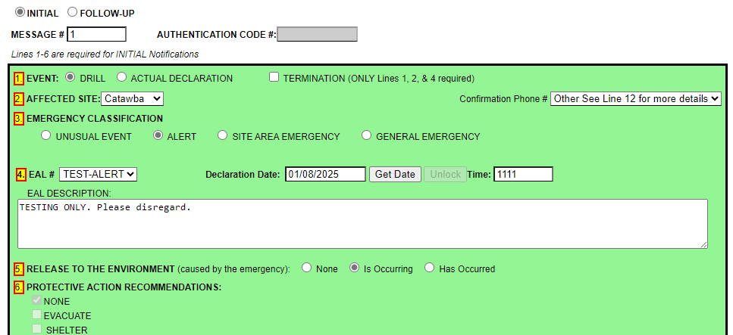
(3) New way to Notify

Slide 11
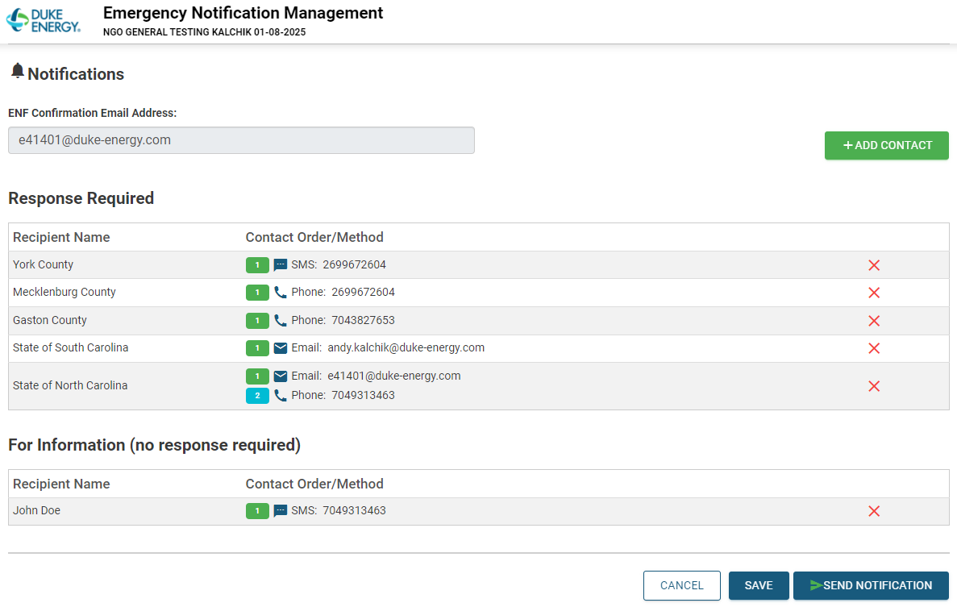
(4) New way to Notify continued
Notes:
Contacts are pre-programed into the board. They can be removed or added when the message is sent

Slide 12
(5) New way to Notify continued

Slide 13
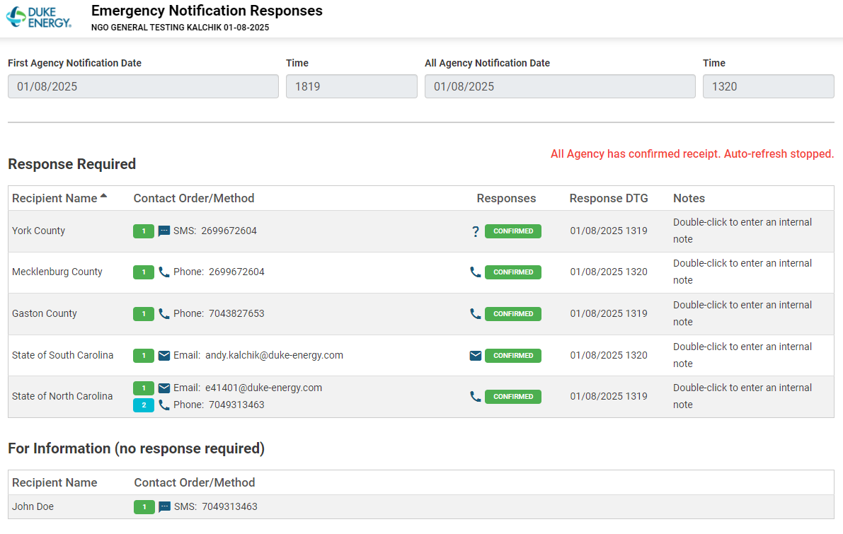
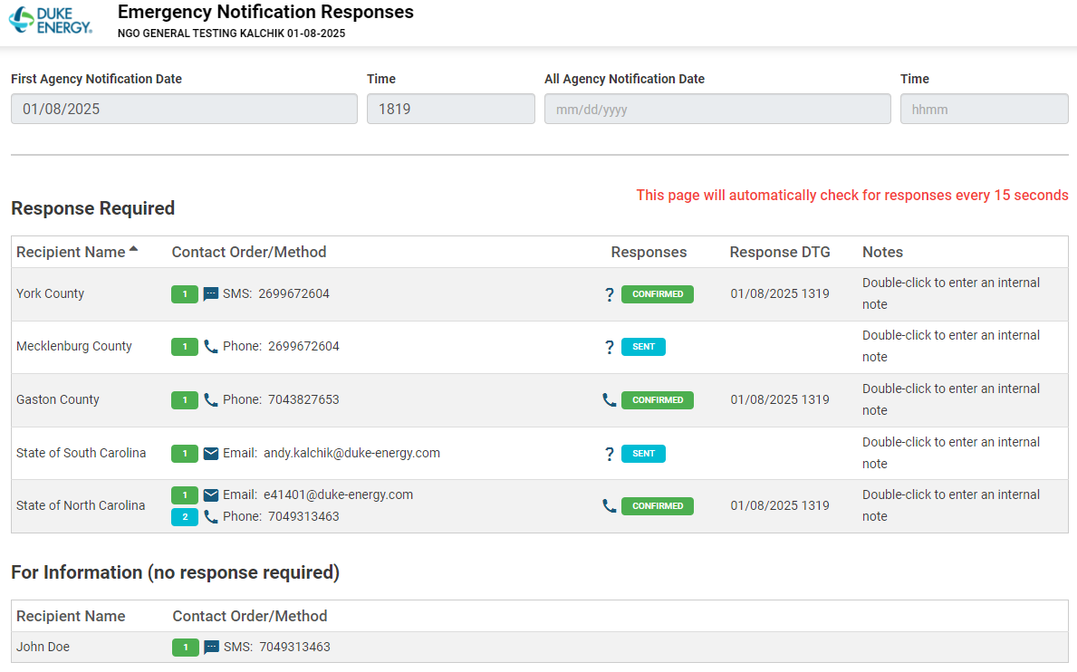
(6) New way to Notify continued

Slide 14
(7) New way to Notify continued

Slide 15
Benefits
Everything is in one place
WebEOC walks them through the steps
Nuclear operators have a clickable menu of options for calling-in emergency responders, rather than digging up a procedure
A nuclear operator no longer sits on a special phone instead of responding to the emergency
State and county 911 operators no longer sits on a special phone instead of responding to other emergencies. They can respond to the message via phone, email, or text

Slide 16
Why we chose this option
Less expensive than custom phone system
Less labor in transition
Already using Everbridge for calling-out emergency responders

Slide 17
Lessons Learned
When using JX Connectors, connect DEV WebEOC to DEV other system
DEV WebEOC was connected to PROD call-out system
Juvare was responsible for the WebEOC development
Duke was responsible for the call-out system
Communications between Duke and Juvare were not clear
This error resulted in delays and the board is still being developed

Slide 18
Summary
Simplified process for nuclear operators
Saves time for 911 operators
Saved money
Connect DEV-to-DEV and PROD-to-PROD

